Slide 1

Lachat Flow Injection Analysis of Reservoir Water Samples

Slide 2
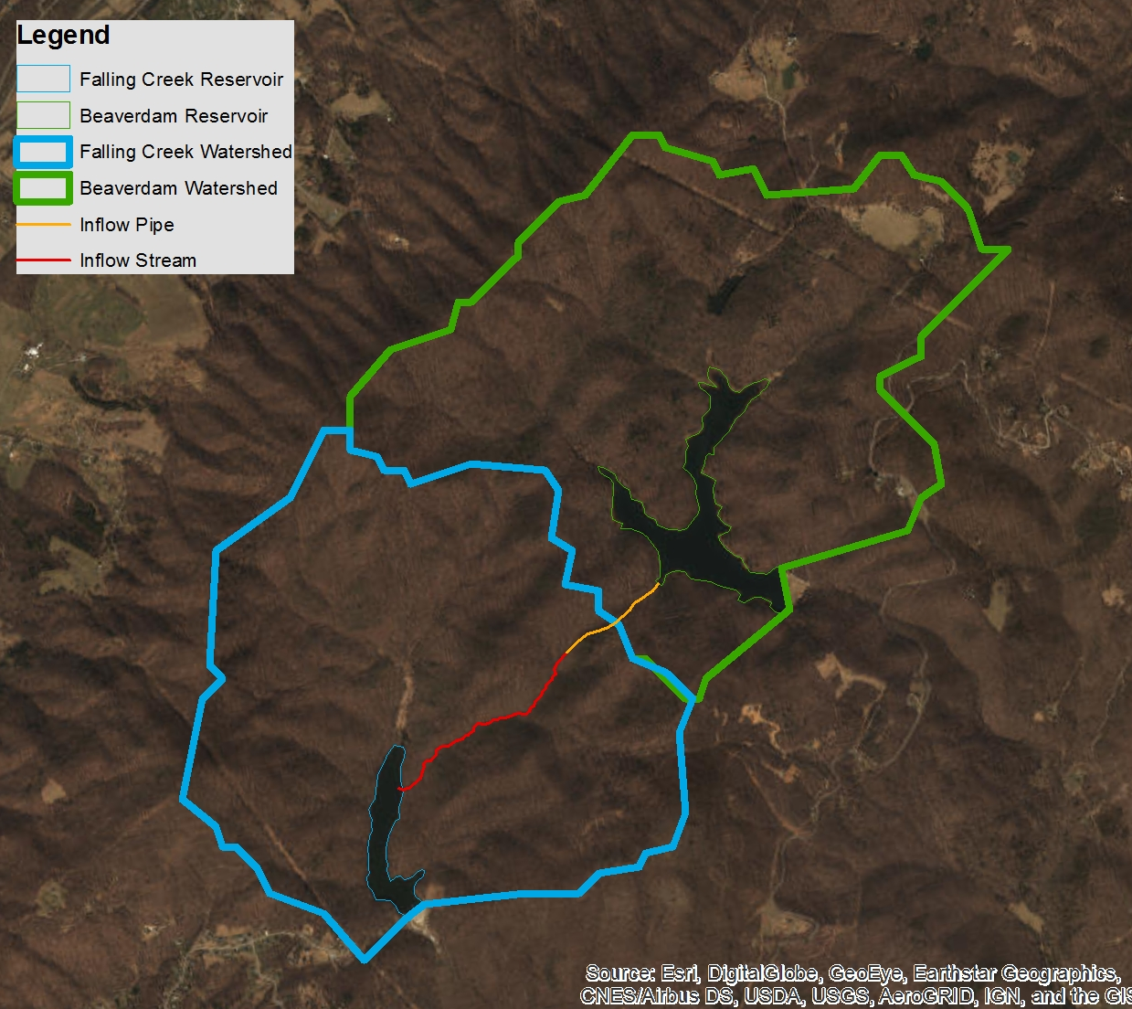
Measuring PO4, NH4, NO3, + NO2 in water
Q1: What is the longitudinal heterogeneity of nitrogen, phosphorus, and chlorophyll-a along a double reservoir continuum?
Q2: What are the drivers of heterogeneity among reservoir continua (i.e., residence time, internal loading)?
2 reservoirs
5 streams
17 sites total
Monthly sampling April-October

Slide 3
Sample collection and processing
Water samples collected at the surface (~0.1m)
Filtered through 0.45 um Whatman GFF filter
Stored frozen until analysis on Lachat
Samples thawed the day before analysis

Slide 4



Slide 5
Calibration using standards on Lachat
Calibration standards created the day of analysis
In ppb PO4, NH4, NO3: 1000, 500, 250, 100, 50, 25, 10, 5, 2.5, 0
Make 1000, 100, 25, and 5 from primary stock
Other auto-diluted from 1000
1000 ppb NO2 standard to check nitrate reduction efficiency
All standards run 3x, integration peaks corrected if necessary, standard curve determined based on the satisfactory peaks
Check standard at 25 ppb, reagent blank, duplicate, and spike (80 uL added to 4mL of sample) run every ten samples

Slide 6
QAQC of data post-Lachat run
Peaks and integrations checked at the end of the run
Integrations edited if needed
Sample re-run if needed
Within QAQC analysis
Nitrate reduction efficiency
Duplicate relative % difference
Spike % recovery
% error in check standard 25 ppb (pass = <20% diff)

Slide 7
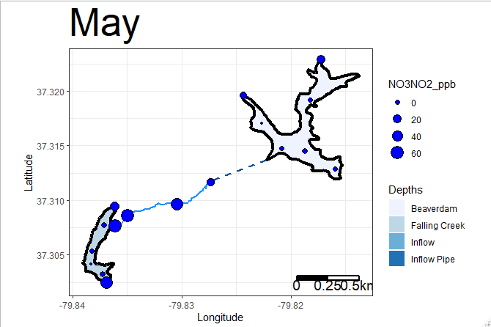
Nitrate/Nitrite

Slide 8
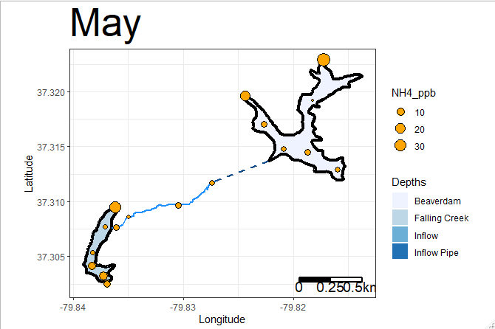
Ammonium

Slide 9
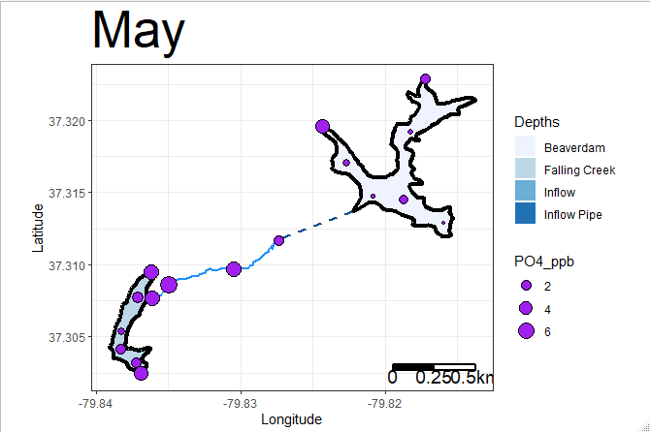
Phosphate

